Slide 1

Assignment
Glance through the below paper

Slide 2
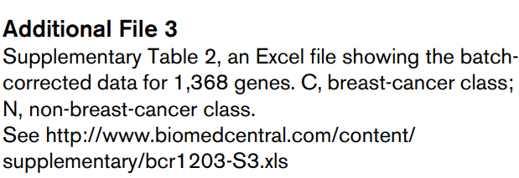
Download the batch corrected data from Table

Slide 3
Apply ML and report LOOCV based
AUC
F1
Precision
Recall
Kappa

